Slide 1

MANAGING SOCIAL RESPONSIBILITY AND ETHICS
6

Slide 2
LEARNING OBJECTIVES
Discuss what it means to be socially responsible and what factors influence that decision.
Discuss the factors that lead to ethical and unethical behavior.
Develop your skill at creating trust in work groups.
Describe management’s role in encouraging ethical behavior.
Know how to make good decisions about ethical dilemmas.
Discuss current social responsibility and ethics issues.

Slide 3
What is Ethics?
Do you follow Ethics in your daily life?
Would you cheat to pass an exam???
Would you lie to get promoted ???
Would you forge documents to get a better position?
Would you copy someone else's work to get good grade?
Would you buy some expensive gifts in return for a good grade or post ??
Would you sell your product on lies to gain more profit???

Slide 4
Ethical Question: Case Question
A university teacher owns a clothing shop and requires students to purchase their uniforms only from his outlet.
👉 Is this socially acceptable and ethically acceptable?

Slide 5
Scenario: 2
Scenario
A teacher tells students that those who join his private tuition academy will receive “better guidance” and are more likely to pass exams.
👉 Question: Is this socially and ethically acceptable?

Slide 6
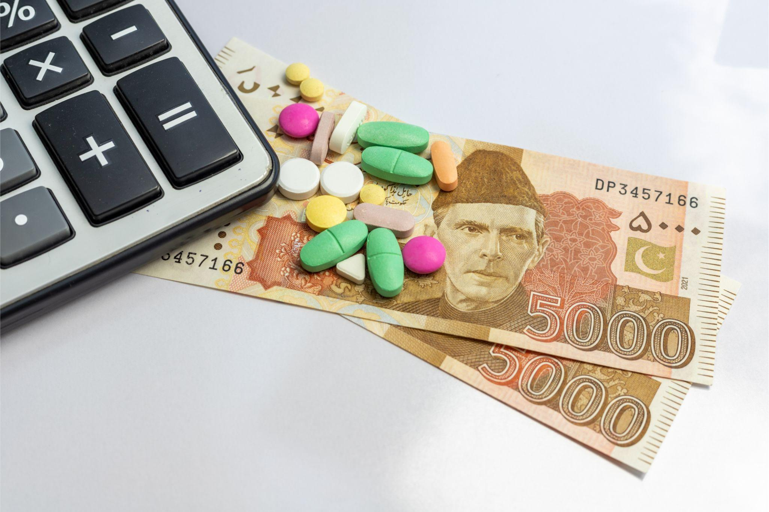
A pharmaceutical company sets a very high price for a life-saving drug to recover R&D costs and maximize profit. Discussion Question 👉 Is this ethically acceptable?

Slide 7


Engro and its Social Responsibilities

Slide 8


Slide 9
FROM OBLIGATION TO RESPONSIVENESS TO RESPONSIBILITY
•
Social Obligation – the obligation of a business to meet its economic and legal responsibilities and nothing more.
Classical view – the view that management’s only social responsibility is to maximize profits.
•

Slide 10
FROM OBLIGATION TO RESPONSIVENESS TO RESPONSIBILITY
Key Characteristics
Proactive and value-driven
Focus on long-term societal impact
Integrated into business strategy
Example: A company invests in education, healthcare, or environmental sustainability without being forced.

Slide 11
FROM OBLIGATION TO RESPONSIVENESS TO RESPONSIBILITY (CONT.)
Socioeconomic view – the view that management’s social responsibility goes beyond making profits to include protecting and improving society’s welfare.
Social responsiveness – when a firm engages in social actions in response to some popular social need.

Slide 12
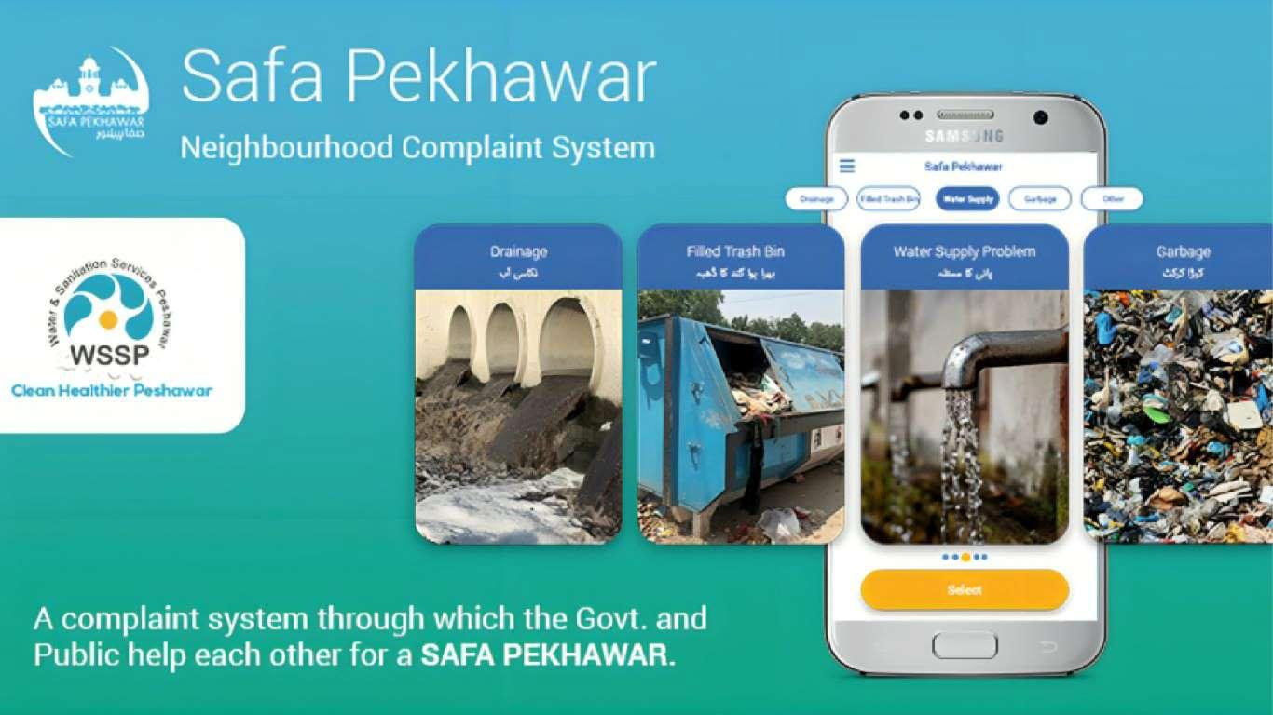

Slide 13
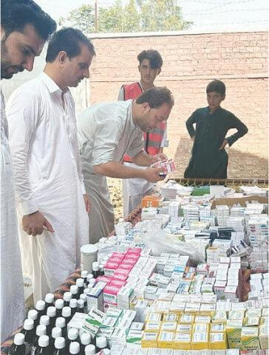

FROM OBLIGATION TO RESPONSIVENESS TO RESPONSIBILITY (CONT.)
Social responsibility – a business’s intention, beyond its legal and economic obligations, to do the right things and act in ways that are good for society.

Slide 14
SHOULD ORGANIZATIONS BE SOCIALLY INVOLVED?
Social Screening – applying social criteria (screens) to investment decisions.
SRI funds usually will not invest in companies involved in liquor, gambling, tobacco, nuclear power weapons, price fixing, fraud, or in companies that have poor product safety, employee relations, and environmental track records.

Slide 15
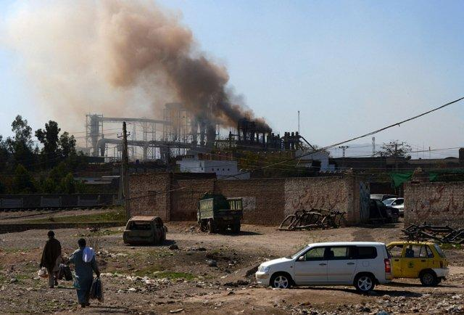
Scenario: A factory in Peshawar is earning good profit but causing pollution in the nearby area. It follows all government laws.
Residents demand:
Cleaner environment
Support for local school
Management says:
“We already follow the law. Social work is not our responsibility.”
Discussion Question
👉 Should the company do more than legal requirements?

Slide 16
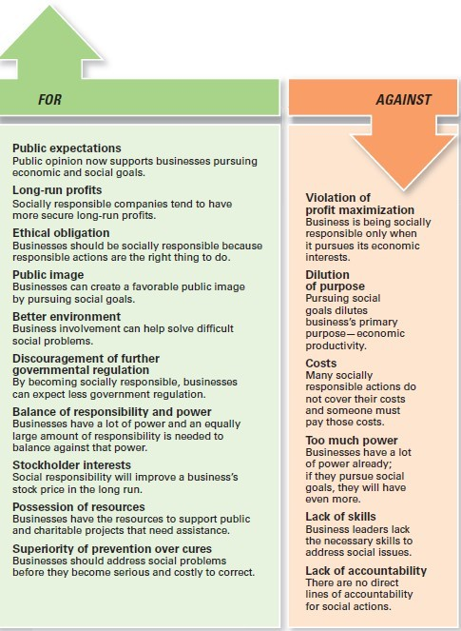
EXHIBIT 6-1
ARGUMENTS FOR AND AGAINST SOCIAL RESPONSIBILITY

Slide 17
GREEN MANAGEMENT AND SUSTAINABILITY
Green Management – managers consider the impact of their organization on the natural environment.
Do we care about the Environment or not ?? If yes then how ? If no then why not ??

Slide 18
HOW ORGANIZATIONS GO GREEN (CONT.)
•
Stakeholder Approach – firms work to meet the environmental demands of multiple stakeholders—employees, suppliers, and the community.
Activist Approach – firms look for ways to respect and preserve the environment and be actively socially responsible.
•

Slide 19
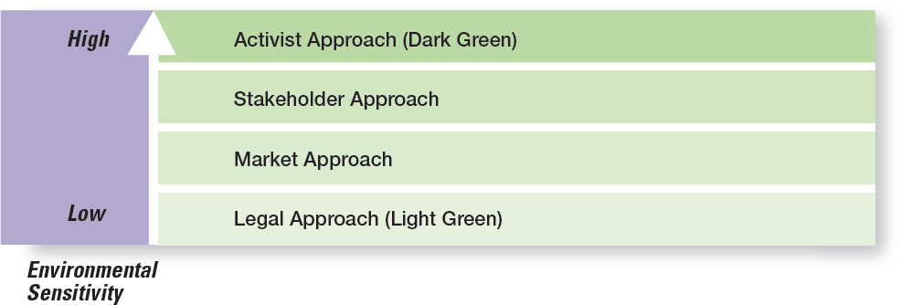
EXHIBIT 6-2 GREEN APPROACHES

Slide 20
MANAGERS
AND ETHICAL BEHAVIOR
Ethics – principles, values, and beliefs that define right and wrong behavior.
Many decisions managers make require them to consider both the process and who’s affected by the result.

Slide 21
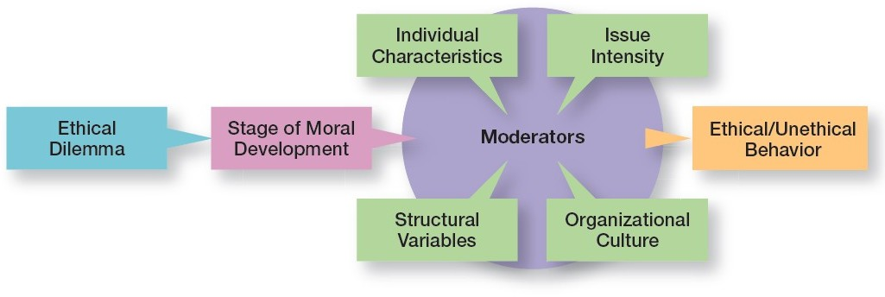
EXHIBIT 6-3
FACTORS THAT DETERMINE ETHICAL AND UNETHICAL BEHAVIOR

Slide 22
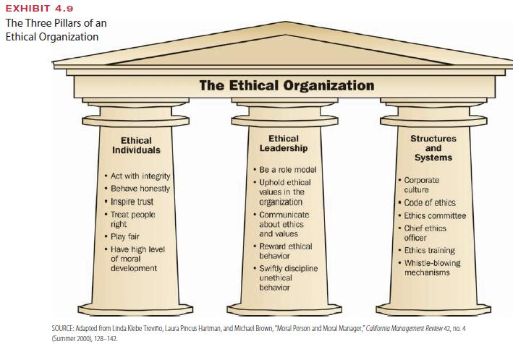

Slide 23
FACTORS THAT DETERMINE ETHICAL AND UNETHICAL BEHAVIOR
Stage of Moral Development
Preconvention level – a person’s choice between right or wrong is based on personal consequences.
Conventional level, ethical decisions rely on living up to the expectations of others.
Principled level, individuals define moral values apart from the authority of the groups or society in general.

Slide 24
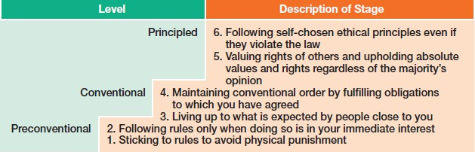
EXHIBIT 6-4
STAGES OF MORAL DEVELOPMENT

Slide 25
FACTORS THAT DETERMINE ETHICAL AND UNETHICAL BEHAVIOR (CONT.)
Individual Characteristics
Values – basic convictions about what is right and wrong.
Ego Strength – a personality measure of the strength of a person’s convictions.
Locus of Control – a personality attribute that measures the degree to which people believe they control their own fate.

Slide 26
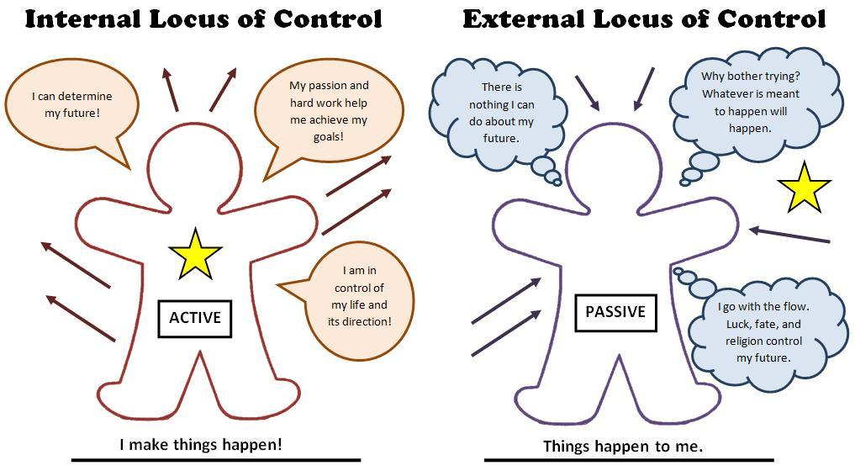

Slide 27
FACTORS THAT DETERMINE ETHICAL AND UNETHICAL BEHAVIOR (CONT.)
Organizational culture..
Organization’s culture consists of the shared organizational values. These values reflect what the organization stands for and what it believes in as well as create an environment that influences employee behavior ethically or unethically.
Values-based management – the organization’s values guide employees in the way they do their jobs.

Slide 28
FACTORS THAT DETERMINE ETHICAL AND UNETHICAL BEHAVIOR (CONT.)
Issue Inte–nsitxycharacteristics determine issue intensity or how important an ethical issue is to an individual:
Greatness of harm
Consensus of wrong
Probability of harm
Immediacy of consequences
Proximity to victim(s)
Concentration of effect

Slide 29
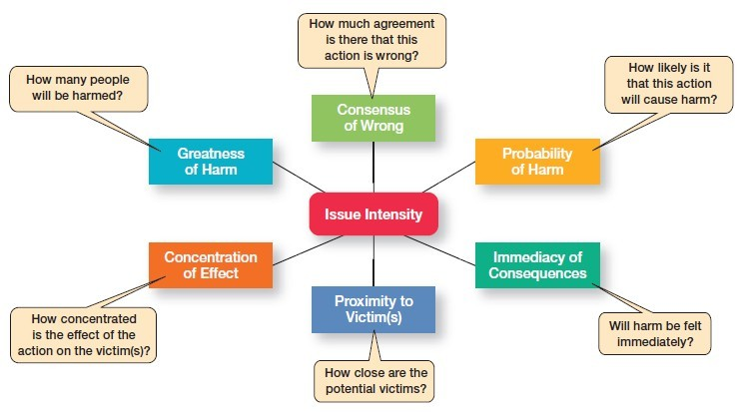
EXHIBIT 6-5 ISSUE INTENSITY

Slide 30
ENCOURAGING ETHICAL BEHAVIOR
Employee Selection – an opportunity to learn about an individual’s level of moral development, personal values, ego strength, and locus of control.
Code of ethics – a formal statement of an organization’s primary values and the ethical rules it expects its employees to follow.
•

Slide 31
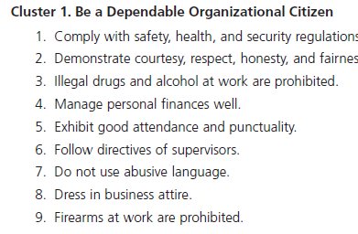
EXHIBIT 6-7 CODES OF ETHICS

Slide 32
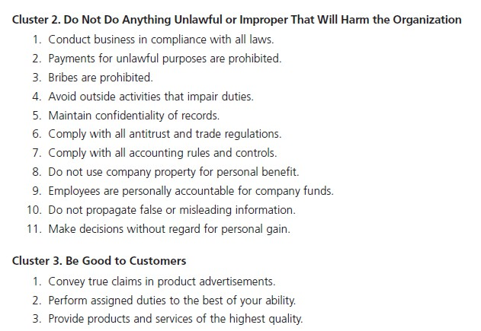
EXHIBIT 6-7 CODES OF ETHICS (CONT.)

Slide 33
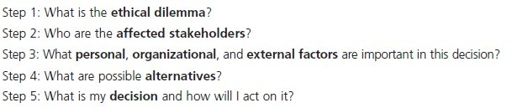
EXHIBIT 6-8
A PROCESS FOR ADDRESSING ETHICAL DILEMMAS

Slide 34
ENCOURAGING ETHICAL BEHAVIOR (CONT.)
Leadersh–ipdoing business ethically requires a commitment from top managers because:
they’re the ones who uphold the shared values and set the cultural tone.
they’re role models in terms of both words and actions.
what they do is far more important than what they say.

Slide 35
ENCOURAGING ETHICAL BEHAVIOR (CONT.)
JobGoals and Performance Appraisal
Unrealistic goals provide stress which may pressure ethical employees to do whatever is necessary to meet those goals.
If performance appraisals focus only on economic goals, ends will begin to justify means.
To encourage ethical behavior, both ends and
means should be evaluated.

Slide 36
ENCOURAGING ETHICAL BEHAVIOR (CONT.)
Ethics Training – seminars, workshops, and similar ethics training programs to encourage ethical behavior.
Independent Social Audits – evaluate decisions and management practices in terms of the organization’s code of ethics.
Protective Mechanisms – allow employees who face ethical dilemmas to do what’s right without fear of reprimand.
•
•

Slide 37
SOCIAL RESPONSIBILITY AND ETHICS ISSUES IN TODAY’S WORLD
Managing Ethical Lapses and Social Irresponsibility
One survey reported that among 5,000 employees: 45 percent admitted falling asleep at work and 22 percent said they spread a rumor about a coworker.
Another showed that 26 percent of college and university business majors admitted to “serious cheating” on exams and 54 percent admitted to cheating on written assignments.

Slide 38
SOCIAL RESPONSIBILITY AND ETHICS ISSUES IN TODAY’S WORLD (CONT.)
Ethical Leadership – managers must provide ethical leadership. What managers do has a strong influence on employees’ decisions whether to behave ethically.
Protection of Employees Who Raise Ethical Issues:
– Whistle-Blower – individuals who raise ethical concerns or issues to others

Slide 39
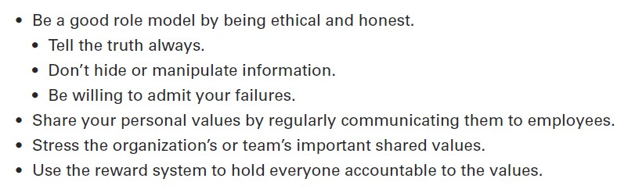
EXHIBIT 6-9
BEING AN ETHICAL LEADER

Slide 40
SOCIAL RESPONSIBILITY AND ETHICS ISSUES IN TODAY’S WORLD (CONT.)
SocialEntrepreneur – an individual or organization who seeks out opportunities to improve society by using practical, innovative, and sustainable approaches.
Corporate Philanthropy – can be an effective way for companies to address societal problems.
Employee Volunteering Efforts – a popular way for businesses to be involved in promoting social change.

Slide 41
REVIEW LEARNING OBJECTIVE 6.1
•
Discuss what it means to be socially responsible and what factors influence that decision.
– Social obligation – a firm engages in social actions because of its obligation to meet certain economic and legal responsibilities.
Social responsiveness – when a firm engages in social actions in response to some popular social need.
–

Slide 42
REVIEW LEARNING OBJECTIVE 6.3
Discuss the factors that lead to ethical and unethical behavior.
Factors that affect ethical and unethical behavior include
an individual’s level of moral development
individual characteristics
structural variables
organizational culture
issue intensity

Slide 43
REVIEW LEARNING OBJECTIVE 6.4
Describe management’s role in encouraging ethical behavior.
The behavior of managers is the single most important influence on an individual’s decision to act ethically or unethically.
Other ways include employee selection, a code of ethics, using means and ends for goals and performance appraisal and ethics training.

Slide 44
REVIEW LEARNING OBJECTIVE 6.5
Discuss current social responsibility and ethics issues.
Ethical leaders also are honest, share their values, stress important shared values, and use the reward system appropriately.
Managers can protect whistle-blowers (employees who raise ethical issues or concerns) by encouraging them to come forward.

